Slide 1
Using Common Core State Standards of Seventh Grade Mathematics in the Application of NXT LEGO® Robotics for CReSIS Middle School Students

Slide 2
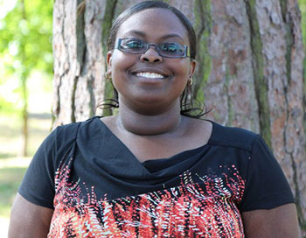
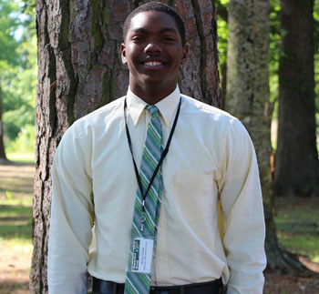
Members
Jessica Hathaway
Elizabeth City State University
Malcolm McConner
Elizabeth City State University
Ricky Dixon
Mississippi Valley State University

Slide 3
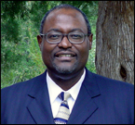
Mentor
Dr. Darnell Johnson
Elizabeth City State University

Slide 4
Overview
Abstract
Introduction
Methodology
5E Learning Model
Results
Conclusion
Future Work
Acknowledgements
Questions

Slide 5
Abstract
In 2010 Common Core Standards included critical content for all students in American education for forty-five states. Previously, every state had its own set of academic standards and students in each state were learning at different levels. In the new global economy, all students must be prepared to compete on a global basis. Students are expected to develop a deeper mastery of content and demonstrate what they know through writing and other projects. The North Carolina Department of Public Instruction’s (NCDPI) current curriculum and instruction are more student-centered with greater focus on skills, abilities, and a shift towards more performance assessments. This research was designed to focus on mathematical processes of the Common Core Standard in mathematics lesson plans for seventh grade students. A group of seventh grade students from two middle schools of Elizabeth City Public Schools in northeastern North Carolina were selected for this research at Elizabeth City State University (ECSU) for the Center of Remote Sensing of Ice Sheets (CReSIS). Pre and post test data were collected through student assessments and teaching observations to evaluate student growth in content knowledge, understanding and application. The Research Experience for Teachers (RET) Team used mathematical strategies to teach various scientific, mathematical, and design concepts, through designing and programming NXT LEGO® Robotics for the seventh grade level. The students received hands on experience for robotics construction and programming with application of mathematics, motion, and problem solving in a collaborative group setting.

Slide 6
Methodology
Constructed a lesson plan using the 5E learning cycle model
Created a pretest of Common Core Standards-7th grade from NCDPI test bank
Reviewed and taught content on incorrect test items’ from the pretest and assigned Math Fun worksheet for homework
Introduced NXT Lego robotics to the students (components, the design, and programming component)
Divided the students into three competitive teams to be monitored by one member for each team of students
Applied Common Core Standards and mathematics skills to assemble and program team robots
Final phase of the research project involved students in programming robots to complete an obstacle course designed by the RET team

Slide 7
5E Learning Model
Engage
Explore
Explain
Elaborate
Evaluate
Each member of the RET team constructed their own lesson plan to teach a different strand of mathematics.

Slide 8
Pre and Post Test
Five Strands for 7th Grade Math
Developed a pretest to assess students knowledge on questions based on the five strands of the Common Core Standards for 7th grade mathematics
Administered posttest to assess growth in student learning after classroom instruction
Ratios and Proportional Relationships
The Number System
Expressions and Equations
Geometry
Statistics and Probability

Slide 9
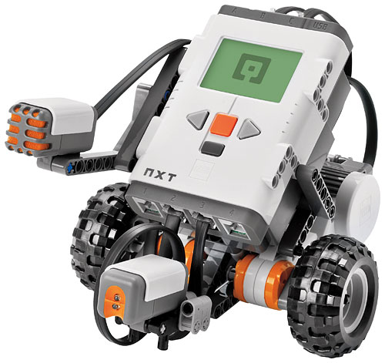
Application of NXT Lego® Robotics
Construction and Programming
Engaged students by displaying a PowerPoint presentation on the construction and programming of the NXT Lego Robots.
Students were responsible to assemble team robots from NXT Lego Set with little assistance from RET members
Students then learned to program robots to do specific tasks
Lastly, the students programmed the robots to complete an obstacle course designed by the RET team

Slide 10
Research Results
Itemized each question and calculated the percentage of students with incorrect answers
Complied scores from the pretest and posttest to analyze the improvement percentage of each student
Developed graphs to display the pretest and posttest scores as well as the improvement scores and percentages of the student test scores

Slide 11
Comparison of Student Scores
Notes:
Each student

Slide 12
Pre and Post Test Scores

Slide 13
Improvement Percentage of Students

Slide 14
Pre and Post Test Comparison

Slide 15
Conclusion
The focus of this research project was to use the principles of the North Carolina Department of Public Instruction’s Common Core Standard for 7th grade mathematics in a 5E lesson plan format and inquiry-based learning in application to Robotics. Effective use of a pretest to measure student content level, teaching needed mathematics skills in selected subjects, and posttest results from the End of Year seventh grade mathematics sample test showed growth in the achievement of Elizabeth City Middle School and River Road Middle School seventh graders.
Twelve highly qualified seventh grade students were selected for this program with nine completing the program. The RET team divided students into three research groups to assemble and program NXT LEGO robots to compete on an obstacle course using basic applications of seventh grade mathematics. Along with classroom observation, data was collected from the students’ scores on the pre and posttest. The numerical range was between thirty-three and seventy-three on the pretest. However, results on the posttest had scores of sixty-three to ninety-three. The mean score of the students improved by twenty points per student with a mean improvement percentage of thirty-eight percent per student. This research resulted in significant improvement in understanding of seventh grade mathematics content.

Slide 16
Future Work
Monitor students’ progress through middle and high school STEM related subjects.
Encourage participation in future CReSIS summer programs.
Survey student choice of career interests in STEM related majors and their college of choice, as well as, the positives of the program and what aspects need improvement.

Slide 17
Acknowledgements
The 2013 Research Experience for Teachers Team would like to thank
CERSER Principal Investigator, Dr. Linda B. Hayden
Mentor, Dr. Darnell Johnson
Graduate student, Michael Jefferson
The REU staff

Slide 18
Questions?
Questions?

